Slide 1

Powershell crash course
Presented by: James Honeycutt

Slide 2
About Me
Husband & Father
25 year Soldier
Howard Community College Instructor
Former Systems Administrator
VP of Outreach ISSA Central Maryland

Slide 3
Agenda
Lecture and Demos
Lunch
Lecture and Demos
CTF
CTF Walkthrough

Slide 4
Why Scripting
We have tools
One offs
GUI is faster
Routine tasks

Slide 5
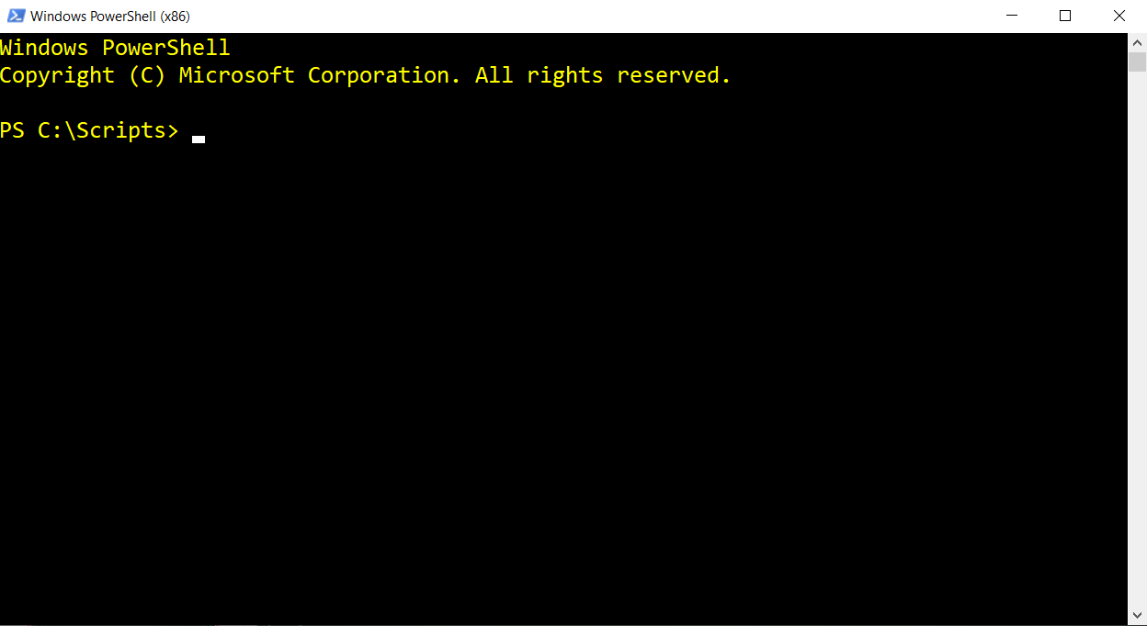
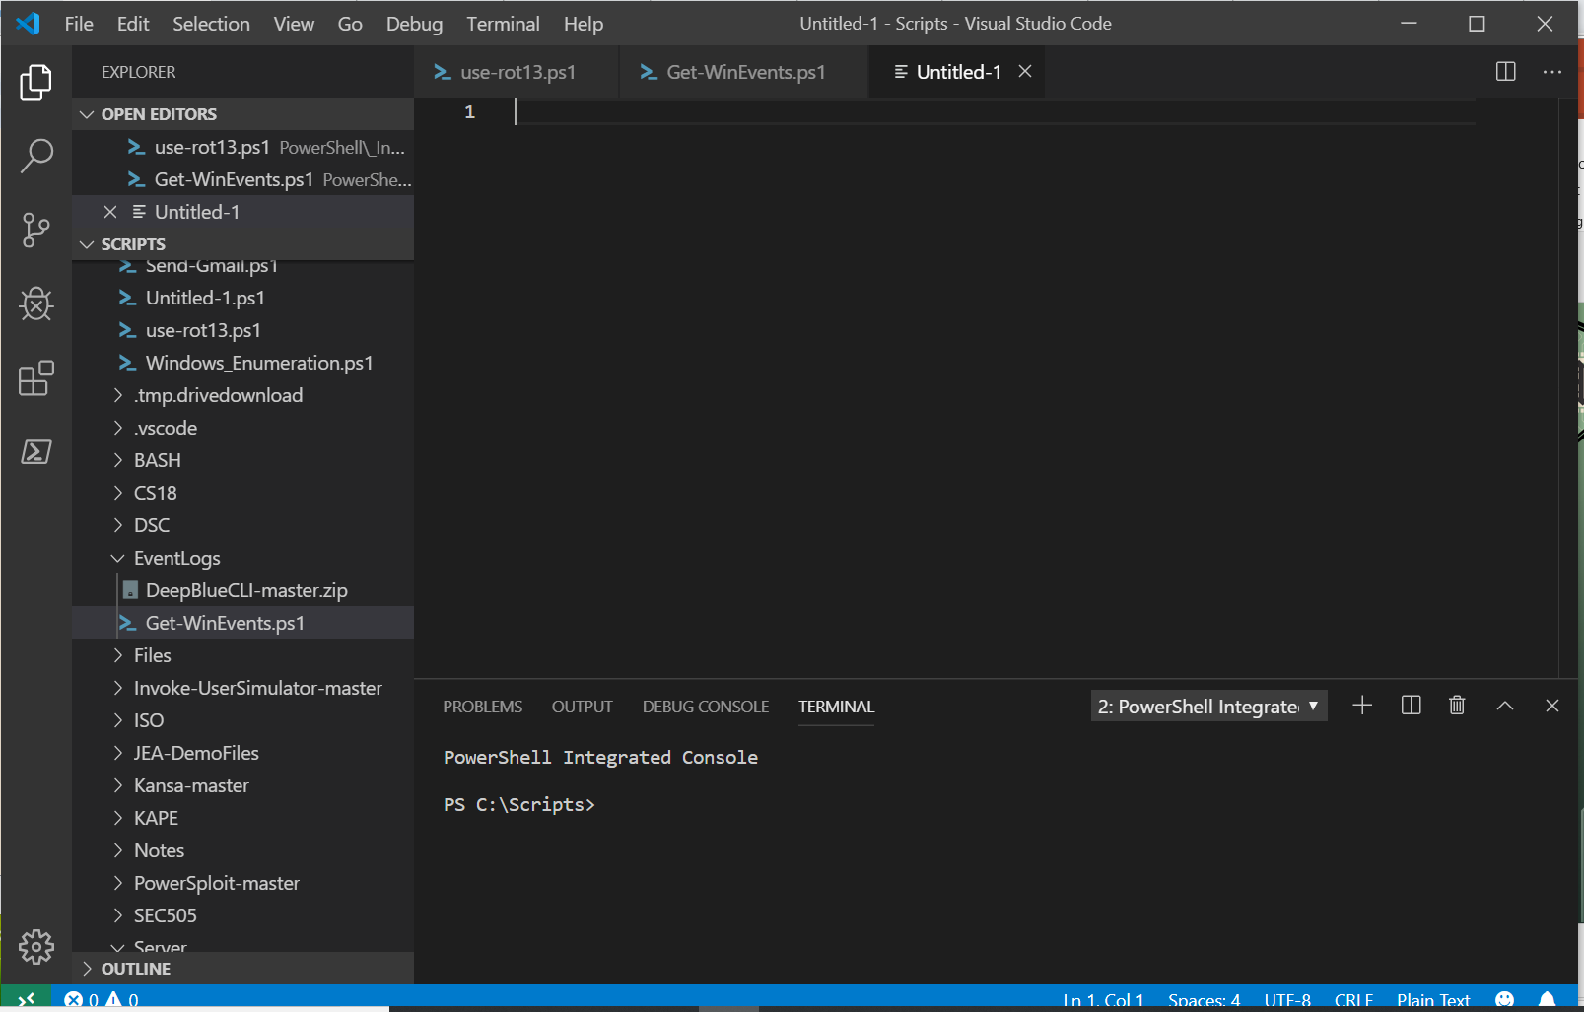
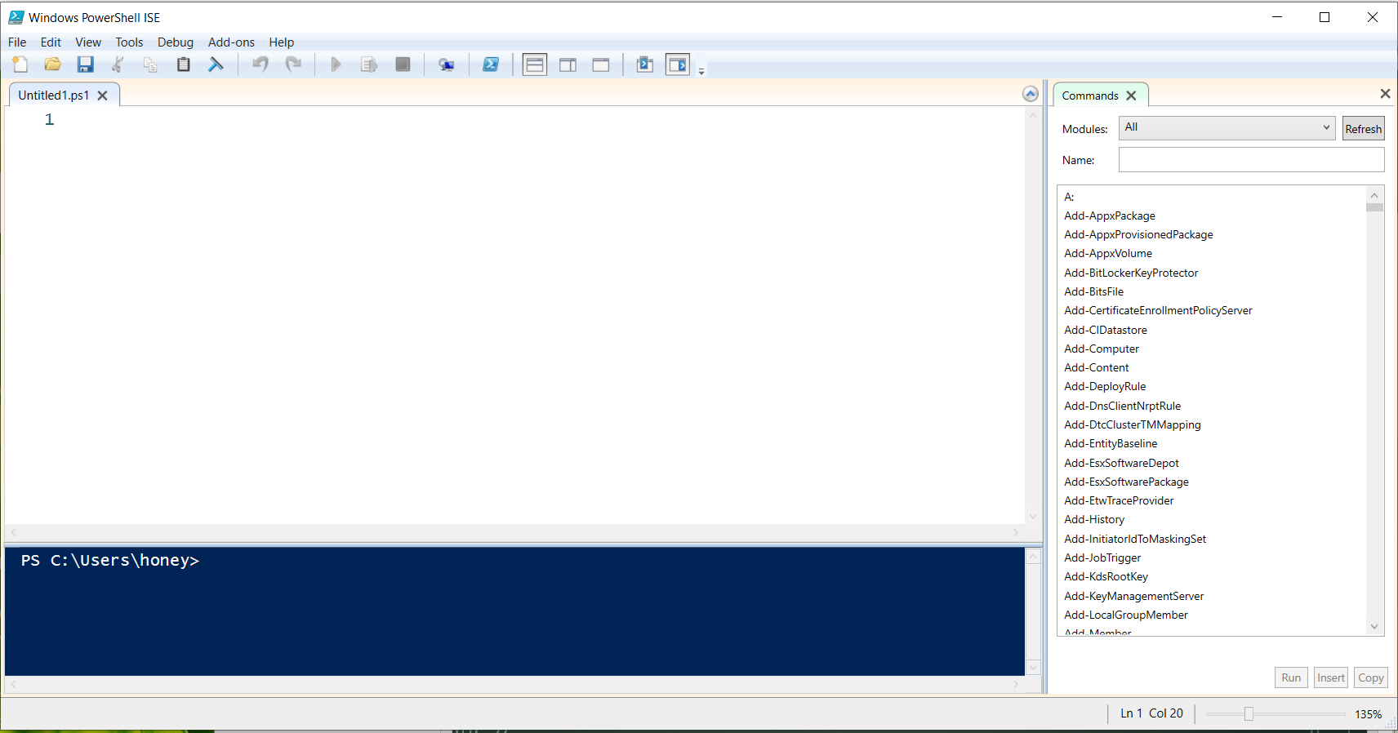
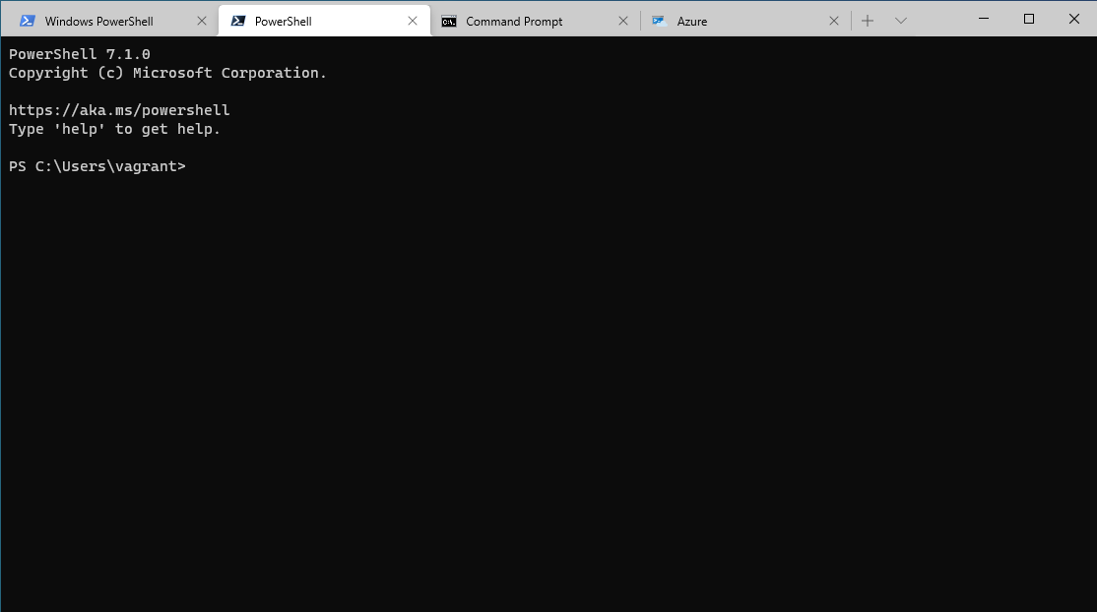
Environments
PowerShell Console
PowerShell ISE
VSCode
Windows Terminal

Slide 6


Slide 7
Powershell lexicon
Cmdlet - native PowerShell command-line utility
Function - a list of PowerShell statements that has a name that you assign
Workflow - a sequence of programmed, connected steps that perform long-running tasks or require the coordination of multiple steps across multiple devices or managed nodes
Application - any kind of external executable, including command-line utilities such as Ping and Ipconfig
Command - the generic term that we use to refer to any or all of the preceding terms.
Aliases – shortcut to a command or cmdlet
Notes:
A cmdlet is a native PowerShell command-line utility. These exist only inside
PowerShell and are written in a .NET Framework language such as C#. The
word cmdlet is unique to PowerShell, so if you add it to your search keywords on
Google or Bing, the results you get back will be mainly PowerShell-related. The
word is pronounced command-let.
A function can be similar to a cmdlet, but rather than being written in a .NET
language, functions are written in PowerShell’s own scripting language.
A workflow is a special kind of function that ties into PowerShell’s workflow execution
system.
An application is any kind of external executable, including command-line utilities
such as Ping and Ipconfig.
Command is the generic term that we use to refer to any or all of the preceding
terms.
An alias is a shortcut to a command

Slide 8
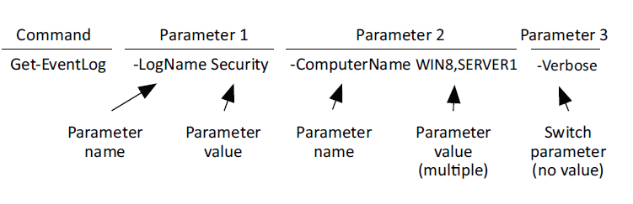
Command Structure

Slide 9
Discovering commands
Update-help
How to discover commands
Get-help
Get-command
Get-member
Optional and mandatory parameters
[[parameter] <type[]>] = optional
[parameter] <type>= mandatory and positional
Parameter <type> = non-positional
Notes:
Demo/Try It Now
Get-Help (get-even)
Get-Command
Get-Member
Show-Command
Get-alias
*Note*
Multiple Parameter sets has unique parameters
Update-Help
get-help *even*
get-help Get-WinEvent
-asstring only works works with computername and list attribute
[[parameter] <type[]>] = optional
[parameter] <type>= mandatory and positional
Parameter <type> = non-positional

Slide 10
External Commands
Ipconfig; ping; nslookup; net; dsmove
& -executes commands
--% directs PowerShell to refrain from interpreting input as PowerShell commands or expressions
Notes:
C:\windows\system32\sc.exe --% qc "bits"

Slide 11
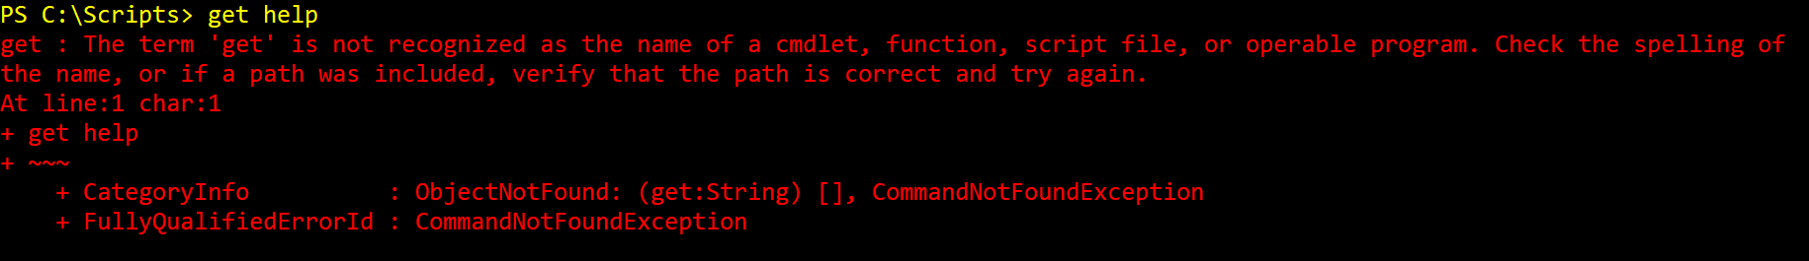
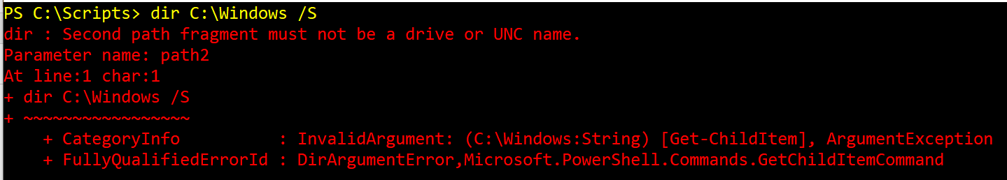
Dealing with errors
Notes:
$error

Slide 12


Slide 13
Providers
get-help about_Providers
Get-psproviders
ShouldProcess
Filter
Credentials
Transactions
Most Providers have the word Item in their cmdlets.
Notes:
ShouldProcess—The provider supports the use of the -WhatIf and -Confirm
parameters, enabling you to “test” certain actions before committing to them.
Filter—The provider supports the -Filter parameter on the cmdlets that
manipulate providers’ content.
Credentials—The provider permits you to specify alternate credentials when
connecting to data stores. There’s a -credential parameter for this.
Transactions—The provider supports the use of transactions, which allows you
to use the provider to make several changes, and then either roll back or commit
those changes as a single unit.

Slide 14
Navigating the filesystem
Profile Scripts
Set-location
New-item
Path parameter
Literal Paths/Relative Paths
* - zero or more characters
? – a single character
Notes:
Get-childitem C:\Scripts\*\?????????.ps1
Get-childitem C:\Scripts\*\????.ps1
Get-childitem C:\Scripts\*\*.ps1
Get-childitem C:\*\*.ps1
Get-childitem C:\*\*\*.ps1
Get-childitem HKLM:\Software\Microsoft\Windows\CurrentVersion\Run
Get-childitem HKCU:\Software\Microsoft\Windows\CurrentVersion\Run
Get-childitem HKLM:\Software\Microsoft\Windows\CurrentVersion\RunOnce
Get-childitem HKCU:\Software\Microsoft\Windows\CurrentVersion\RunOnce
Measure-Command -Expression {Get-childitem HKCU:\Software\*\*\*\}
Measure-Command -Expression {Get-childitem HKCU:\Software\Microsoft\Windows\CurrentVersion}

Slide 15
Objects
Object - It represents a single thing, such as a single process or a single service.
Property - It represents one piece of information about an object, such as a process name, process ID, or service status.
Method - A method is related to a single object and makes that object do something - for example, killing a process or starting a service.
Collection - This is the entire set of objects
Notes:
Tasklist pull information, but cannot perform any actions
Get-Process | ConvertTo-HTML | Out-File processes.html
get-process | get-member | where {$_.membertype -eq 'Property'} | group MemberType | sort count –Descending
(Get-service –name bits).start()
(Get-service –name bits).stop()
Get-Service * | where {($_.starttype -like "man*") -and ($_.status -eq "Stopped")} | Select-Object -Property Name, Status, StartType
get-service * | where {$_.starttype -like "man*"} | select Name, Status, StartType | group status | sort count –Descending
Get-Process | Sort VM -descending | gm
Get-Process | Sort VM -descending | Select Name,ID,VM | gm

Slide 16
Objects (cont)
ScriptProperty -
Property -
NoteProperty -
AliasProperty -

Slide 17
Variables
Place to store your stuff
Usually contain letters, numbers, and underscores
Variable names can contain spaces
Try to make variable names sensible

Slide 18
Variables in quotes
Single quotes are a literal string; variable will not expand
Double quotes will execute variables and commands
`(backtick) escapes the variable expansion and command execution
`n is a newline
Access by index number
Notes:
$var = 5
$String = ‘What does $var contain?’
$String2 = “What does $var contain?”
$var = 89; $string2
$string3 = "`$var contains $var“
"`$(get-date) is how you execute a command within quotes“
$object1 = 'Object01 Object02 Object03’
$object2 = 'Object01','Object02','Object03'
$objectList = "Object01 `nObject02 `nObject03“
$ListVariables = 'Object1', 'Object2', 'Object3', 'Object4’
$var[0]
$var[-1] last object
$var[-2] 2nd to last objects
$var.length
$var.touppper()
$var.tolower() $var.replace()

Slide 19
More Variable Stuff
Declaring Variables
Access variable by property
$_. – object coming across the pipeline
$() – subexpression
Notes:
$services = Get-service
$services.name
Get-Service | ForEach-Object { Write-Output $_.Name }
$today = “Today is get-date”
$today = "Today is $($(get-date).DayOfWeek) the $($(get-date).day)th"
$number = Read-host “Enter a number: “
[int]$number = Read-host "Enter a number"

Slide 20
Variable Types
[single] - Single(32)-precision
[double] - double(64)-precision floating numbers (numbers with a decimal portion)
[string]—A string of characters
[char]—Exactly one character [xml]—An XML document
[adsi]—An Active Directory Service Interfaces (ADSI) query
[char] - A Unicode 16-bit character
[byte] - An 8-bit unsigned character
[int] - 32-bit signed integer
[long] - 64-bit signed integer

Slide 21
Variable Types (cont.)
[bool] Boolean True/False value
[decimal] A 128-bit decimal value
[DateTime] Date and Time
[array] An array of values
[hashtable] Hashtable object

Slide 22
Variable Comands
New-Variable
Set-Variable
Remove-Variable
Get-Variable
Clear-Variable
Get-ChildItem Env:

Slide 24
The Pipeline
Connects one command to another
Exporting CSV or XML
Comparing Files
Out-file or Out-printer
Out-Gridview
Convertto-html
Notes:
Get-Service | ConvertTo-HTML | Out-File services.html
Get-Process -name Notepad | Stop-Process
get-process | export-csv c:\temp\processes.csv -NoTypeInformation

Slide 25
deeper Pipe line
CommandA sends output to CommandB
CommandB has to property that accepts pipeline input from CommandA
ByValue – Match only one pipeline input ByValue
Get-content .\servers.txt | Get-service (fail)
Get-process -name note* | stop-process(win)
ByPropertyName - Matches all that accept pipeline input ByPropertyName
Notes:
Get-help get-service –full
Get-content .\servers.txt | Get-service (fail)
Get-process -name note* | stop-process(win)

Slide 26
Logic and flow control
IF/Else - run code blocks if a specified conditional test evaluates to true
if (<test1>) {<statement list 1>}
[elseif (<test2>) {<statement list 2>}]
[else {<statement list 3>}]
Switch - To check multiple conditions
Switch (<test-value>)
{ <condition> {<action>}
<condition> {<action>} }
Notes:
If/Elses
$a = 1
if (($a -gt 2) -and ($a -le 10))
{Write-Host "The Value $a is greater than 2 less than 10."}
elseif ($a -le 2)
{Write-Host "The value $a is less than 2."}
else {Write-Host "The value $a is greater than 10."}
code “C:\Scripts\PowerShell\UserAccounts\Uploaded to GitHub\New-ADUser_Prompted.ps1”
Switch
$a = 3
switch ($a)
{
1 {"It is one."}
2 {"It is two."}
3 {"It is three."; Break}
4 {"It is four."}
3 {"Three again."}
}
code C:\Scripts\PowerShell\Vmware\ViewVM-SetState.ps1

Slide 27
Logic and flow control
Foreach – iterates through a series of values
foreach ($<item> in $<collection>){<statement list>}
For - use to create a loop that runs commands in a command block while a specified condition evaluates to true
for (<init>; <condition>; <repeat>)
{<statement list>}
Notes:
ForEach
$letterArray = "a","b","c","d“
foreach ($letter in $letterArray) {Write-Host $letter}
code “C:\Scripts\PowerShell\UserAccounts\Uploaded to GitHub\Get-InactiveUsers.ps1”
For
for($i=1; $i -le 100; $i++){Write-Host $i}

Slide 28
Logic and flow control
Do-Until - the script block runs only while the condition is false
do {<statement list>} until (<condition>)
Do-While - condition is evaluated after the script block has run
do {<statement list>} while (<condition>)
While - runs commands in a command block as long as a conditional test evaluates to true
while (<condition>){<statement list>}
Notes:
Do-Until
code C:\Scripts\PowerShell\UserAccounts\lockaccounts.ps1
Do-While
code C:\Scripts\PowerShell\_InProgress\Generate-Files.ps1
While
code C:\Scripts\PowerShell\UserAccounts\Invoke-RandomUser.ps1

Slide 29
Adding commands
Just like adding snap-ins into the MMC console
Snapins
Add; get; remove-pssnapin
Modules
New hotness
Import-module; Get-module
Auto load modules
$env:PSModulePath
Notes:
Snapins
Code “C:\Scripts\PowerShell\VMware\Uploaded to GitHub\Refresh-availableVMs.ps1”
Modules
Code “C:\Scripts\PowerShell\VMware\Uploaded to GitHub\New-ADUser_Prompted.ps1”
Code “C:\Scripts\PowerShell\VMware\Uploaded to GitHub\Export-OVA.ps1”
Get-module –listavailable
Get-command *host*
Get-help get-host
Get-help get-vmhost
$env:psmodulepath
get-module -ListAvailable VM* | foreach ($Module -in $_.name) { Uninstall-Module -Name $Module}

Slide 30
Module from Internet
Uses PowerShellGet
Does NOT work with FIPS compliance turned on
Register-PSRepository to add the URL of a repository
Set-PSRepository
Find-Module
Install-Module
Notes:
get-command *sql*
Find-module *sql*
Install-module SqlServer
get-command *sql*
get-command -module SqlServer
Set-PSRepository –name “MyLocalStore”
Profile Scripts

Slide 31
Output formatting
Default formatting rules controlled by .ps1xml
Format-Table
Format-list
Format-Wide
Custom Columns
Other Out-* Commands
Notes:
Third formatting rule
i) Four or less properties; format as table
ii) Five or more properties; format as list
Format-Table
-autosize (adjusts to column width)
(1) Get-Process | select -last 15 | Format-Table
ii) -property (instead of piping to select)
(1) Get-Process | select -last 15 | Format-Table -Property MachineName, ID, ProcessName, responding
iii) –groupBy
(1) Get-Service | Sort-Object Status | Format-Table -groupBy Status
iv) –wrap
(1) Get-Service | Format-Table Name,Status,DisplayName -autoSize –wrap
Format-Wide (wide list)
i) Grabs “name” property and creates a 2 column list
ii) -column to change the # of columns
iii) -property select other property instead of name property
Format-list
-property
Get-Process | Format-list -Property Name,ID
-groupBy
Get-Process | Format-list -Property Name,ID -GroupBy name
-others
get-command out-*
Get-Service | Group-Object -Property Status | Sort-Object -Property Count -Descending | ConvertTo-Json | Out-File .\Services.json
Custom Columns
Get-Process | select -first 5 | Format-Table -Property name,vm
Get-Process | select -first 5 | Format-Table Name, @{name='VM(MB)';expression={$_.VM / 1MB -as [int]}} –autosize
Code “C:\Scripts\PowerShell\Server\Uploaded to GitHub\Get-ServerRebootStatus.ps1”
$userData = Import-Csv 'C:\Users\honey\Google Drive\Presentations\PowerShell\PowerShell Crash Course\UserData.csv'
$userData | select -First 5 | Format-Table -property ID, @{name='FName';expression={$_.first_name}}, @{name='LName';expression={$_.last_name}}, email, gender
$userData | select ID, @{name='FName';expression={$_.first_name}}, @{name='LName';expression={$_.last_name}}, email, gender | export-csv 'C:\Users\honey\Google Drive\Presentations\PowerShell\PowerShell Crash Course\temp.csv' -NoTypeInformation
get-command out-*

Slide 32
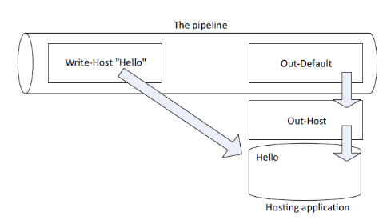
Write-host
Notes:
write-host "COLORFUL!" -fore yellow -back magenta
Anything written to the screen (-host) cannot be captured.
i.e unattended script or remote commands (invoke)
Best practice is to use Write-Verbose
Used for “warm and fuzzy messages”
Connecting to xyz server
Testing connecton

Slide 33
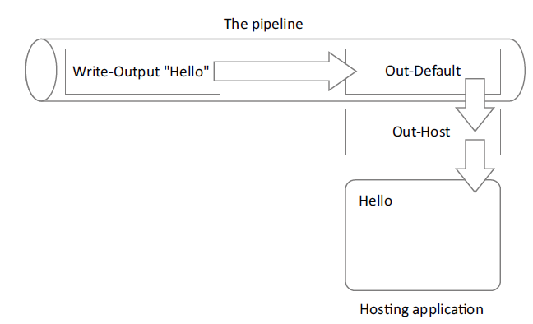
Write-output
Notes:
Can send objects into the pipeline
Write-output Hello
write-output "Hello" | where-object { $_.length -gt 3 } | out-default | write-host

Slide 34
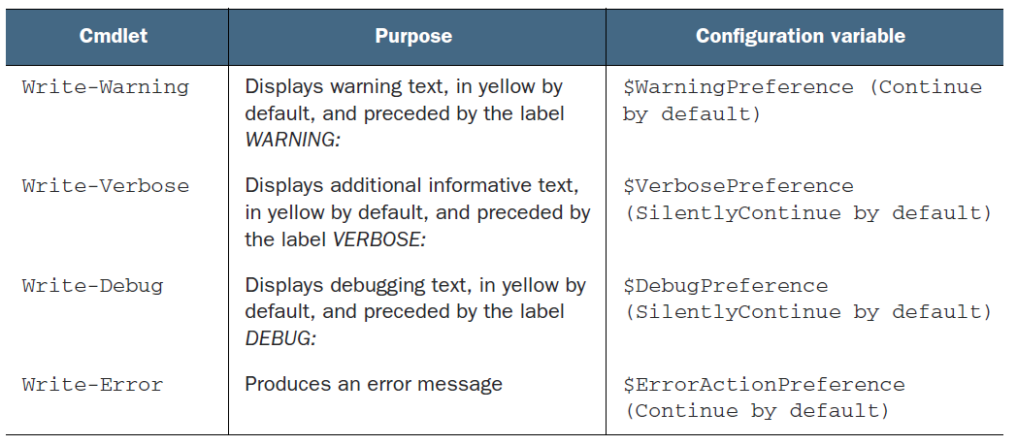
Other output
Notes:
Write-Information (v5)
Write-host is a wrapper
May need -informationaction continue
Write-Progress
can display progress bars
Write-verbose
Write-Verbose "Test Message" –Verbose
Write-Information
Get-ChildItem C:\Users\honey\Documents\*.pdf; Write-Information -MessageData "Here are your PDFs!" -InformationAction Continue

Slide 35
Other Output (cont.)
Write-error
it writes an error to PowerShell’s error stream
Write-Information (v5)
Write-host is a wrapper
May need -informationaction continue
Write-Progress
can display progress bars
Notes:
$error
Write-error
it writes an error to PowerShell’s error stream
Write-Information (v5)
Write-host is a wrapper
May need -informationaction continue
Get-ChildItem C:\Users\honey\Documents\*.pdf; Write-Information -MessageData "Here are your PDFs!" -InformationAction Continue
Write-Progress
can display progress bars

Slide 36
Read-Host
A colon is added to the end of the prompt
Whatever the user types is returned as the result of the command (technically, it’s placed into the pipeline).
[void][System.Reflection.Assembly]::LoadWithPartialName('Microsoft.VisualBasic')
$computername = [Microsoft.VisualBasic.Interaction]::InputBox('Enter a computer name','Computer Name','localhost')
Notes:
read-host "What is your name?“
Code “C:\Scripts\PowerShell\UserAccounts\Uploaded to GitHub\New-ADUser_Prompted.ps1”
[void][System.Reflection.Assembly]::LoadWithPartialName('Microsoft.VisualBasic’)
[void] - part is converting the result of the command into the void data type.
an object that does not have a value of any type data type is a special type that means “throw the result away.”
Another way to do the same thing would be to pipe the result to Out-Null.
[System.Reflection.Assembly] – represents our application
enclosed the type name in square brackets, as if we were declaring a variable to be of that type
we’re using two colons to access a static method of the type
Static methods exist without us having to create an instance of the type.
LoadWithPartialName ()
static method we’re using
accepts the name of the framework component we want to load.
$computername = [Microsoft.VisualBasic.Interaction]::InputBox('Enter a computer name','Computer Name','localhost’)
[Microsoft.VisualBasic.Interaction]
Loaded into memory with the previous command
'Enter a computer name’
The first parameter is the text for your prompt.
'Computer Name’
The second parameter is the title for the prompt’s dialog box.
'localhost’
The default value that you want prefilled in the input box.

Slide 37


Slide 38
Filtering
Filter as far left as possible (-filter)
Each cmdlet has its own way to filter
Get-service can filter -name only
Get-adcomputer can filter on any attribute
Filtering out of pipeline
Where-object is used when there is no -filter or you cannot filter on the property you want

Slide 39
comparison
Comparison Operators
-eq (=) = Equal
-ne (<>)= Not Equal
-ge (>=)and -le (<=) = Greater than or equal to; less than or equal to
-gt (>) and -lt (<) = Greater than; less than
-ceq, -cne, -cgt, -clt, -cge, -cle = case sensitive

Slide 40
Comparison (cont.)
Stacking comparisons
And – both comparisons have to be $True
OR – one or the other have to be $true
Not - reverses $true and $false
Other String comparisons
-like; -notlike; -clike; -cnotlike
-match, -notmatch, -cmatch, -cnotmatch
Notes:
get-service | where-object {$_.status -eq 'running’ }
Get-Service | Where Status -eq 'Running’
Simple; new in v3; good when only comparing 1 object
get-service | where-object {$_.status -eq 'running' -AND $_.StartType -eq 'Manual’}
Original syntax; used for multi compare
Get-Process | Where-Object -filter { $_.Name -notlike 'powershell*' } | Sort VM -descending | Select -first 10 | Measure-Object -property VM –sum
Code “C:\Scripts\PowerShell\UserAccounts\Uploaded to GitHub\New-ADUser_Prompted.ps1”

Slide 41
Remote PowerShell
-computername
Remote PowerShell
Similar to Telent and SSH
Uses WS-Man protocol (Web Services for Management)
WinRM is MS implementation of WS-MAN
Must configure WinRM on machines that will receive remote PS connections
XML format of object is sent back to originating machine
Notes:
Remote PowerShell
Similar to Telent and SSH
Uses WS-Man protocol (Web Services for Management)
Over http (5985) and https (5986)
WSMan: drive manages remote sessions
Get-ChildItem WSMan:\localhost\Shell
IdleTimeout - specifies the amount of time a session can be idle before it’s shut down automatically
MaxConcurrentUsers - specifies the number of users who can have a session open at once
MaxShellRunTime - determines the maximum amount of time a session can be open.
MaxShellsPerUser - sets a limit on the number of sessions a single user can have open at once
Get-ChildItem WSMan:\localhost\Service\
MaxConnections - sets the upper limit on incoming connections to the entire remoting infrastructure.
WinRM is MS implementation of WS-MAN
Installed and enabled by default on Servers 2012r2 and up
Installed and disabled by default on Win7 and up
XML format of object is sent back to originating machine
Serialization – to XML format
Deserialization – from XML format
Only a snapshot
Must configure WinRM on machines that will receive remote PS connections
Enable-PSRemoting (call Set-WSManQuickConfig; starts and sets WinRM service to autostart, Registers PowerShell as an endpoint; creates needed firewall rules.
Any adapter set to Public can’t have Windows Firewall exceptions
Test-WSMan
Get-PSSessionConfiguration
Enable-PSRemoting -SkipNetworkProfileCheck -Verbose

Slide 42
Enter-PSSession
Type commands directly on connected server
Must use real name. By default it will not let you use IP or other DNS alias
Profile scripts don’t carry over
Execution policy still exists
Exit-PSSession ends the session
Closing the terminal ends the session
Avoid remote chains
Notes:
enter-pssession localhost
enter-pssession DESKTOP-52INA1A -Credential desktop-52ina1a\honey

Slide 43
Invoke-command
One-to-many
PowerShell talks to up to 32 computers at once
Can use -throttle to talk to more than 32
-command is alias for -scriptblock
Can use get-content computers.txt or get-adcomuters for -computername
Notes:
Invoke-Command -computerName localhost, DESKTOP-52INA1A -Credential $creds -command { Get-EventLog Security | where {$_.eventID -eq 4826}}
Code “C:\Scripts\PowerShell\Server\Uploaded to GitHub\Get-ServerRebootStatus.ps1”

Slide 44
Invoke-command vs. computername
Computername
computers are contacted sequentially and could take longer
does not contain a PSComputerName property so results my be hard to separate
connection is not made with WinRM
Processing is done on local computer; so all records are brought across the wire then filtered
Results are live and don’t need to be serialized or deserialized (fully functional Objects)

Slide 45
Invoke-command vs. computername (cont.)
Invoke-command
Computers are contacted in parallel; command could run more quickly
Output contains a PSComputerName property so results are more distinguishable
Is used over WinRM; so firewall rules can be enabled
Queries and filters on remote computer then results are sent back to local machine
Results need to be serialized and deserialized before and after transmitting over the wire (snapshot results) (limited objects)
Notes:
get-service XblGameSave | start-service
Invoke-Command -computerName localhost, DESKTOP-52INA1A -Credential desktop-52ina1a\honey -command {get-process –name notpad | stop-process}
Get-process -ComputerName desktop-52ina1a -Name notepad
Decentralized objects (demo
Get-service | get-member
Invoke-command -computername DESKTOP-52INA1A -Credential desktop-52ina1a\honey -scriptblock {get-service} | get-member

Slide 46
Sessions
New-PSSession
Can be used to connect to several machines and stored as a variable
Disconnect-PSSession
Connect-PSSession
Remove-PSSession
Enter-PSSession –session
Invoke-command –session
Notes:
$sessions = New-PSSession -ComputerName localhost, DESKTOP-52INA1A -Credential desktop-52ina1a\honey
Disconnect-PSSession
Disconnects from the session, but leaves the connection
Same domain admin can see the connection of a different computer
Admin creates session on Comp1 to Comp2, then disconnects session, logs into Comp3 and checks sessions on Comp2, sees his disconnected session
Connect-PSSession
Remove-PSSession
Enter-PSSession -Session $sessions [0]
Enter-PSSession -Session ($sessions |where { $_.computername -eq ‘localhost’ })
Enter-PSSession -Session (Get-PSSession | where {$_.computername -eq 'localhost’})
$s_server1,$s_server2 = new-pssession -computer localhost, DESKTOP-52INA1A -Credential desktop-52ina1a\honey
Invoke-Command -Command { Get-WmiObject -Class win32_process } -Session $sessions | Format-Table -Property PSComputerName, processname, ProcessID, ParentProcessID
invoke-command -command { get-wmiobject -class win32_process } -session $sessions | Select-Object ProcessName, PSComputerName, Path | Group-Object ProcessName | Sort-Object Count -Descending | Format-Table -AutoSize

Slide 47
Advanced remoting configuration
Uses custom endpoint configurations
Enable multi-hop remoting
Mutual Authentication
Mutual authentication via SSL
TrustedHosts
Notes:
Advanced remoting configuration
Uses custom endpoint configurations (reference my JEA Talk)
Enabling multihop remoting
Second Hop Problem
Enable-WSManCredSSP -Role Client -DelegateComputer $computer (2nd Hop Computer)
Enable-WSManCredSSP -Role Server (ran on middle man computer
Digging deeper into remoting authentication
PowerShell remoting employs mutual authentication
Mostly take care of in a domain environment
The name must resolve to an IP address.
The name must match the computer’s name in the directory.
Mutual authentication via SSL
you need to obtain an SSL digital certificate for the destination machine
you need to create an HTTPS listener
https://leanpub.com/secretsofpowershellremoting
TrustedHosts
Shuts off Mutual Authentication
The TrustedHosts item can contain a comma-separated list of computer names, IP addresses, and fully-qualified domain names.
Wildcards are permitted.
Get-Item wsman:\localhost\Client\TrustedHosts
Set-Item wsman:localhost\client\trustedhosts -Value *

Slide 48
Implicit remoting: importing a session
$session = new-pssession -comp server-r2
Establish a remote connection to server with ADTools installed
invoke-command -command { import-module activedirectory } session $session
Tell the remote computer to load the AD module
import-pssession -session $session -module activedirectory -prefix rem
import the AD PowerShell Module and prefix the commands with rem
Notes:
Code “C:\Scripts\PowerShell\UserAccounts\RemoveUser_Prompted.ps1”
PowerShell creates a temporary local module with shortcuts to the commands on the remote server
Results brought back through the session are decentralized and do not have methods

Slide 50
Windows Management Instrumentation (WMI)
Tens of thousands of Management Information
Organized into Namespaces
Root/CIMv2 – OS and hardware information
Root/MicrosoftDNS – DNS Server Information
Root/securityCenter – Firewall, antivirus, and antispyware information
Instance is a real thing represented
Old cmdlets (Get-WMIObject and Invoke-WMIMethod)
Notes:
ROOT\CIMV2\Win32_LogicalDisk
Get-WmiObject -Namespace root\CIMv2 -list | where {$_.name -like '*dis*’}
Get-WmiObject -class win32_desktop -filter "name='DESKTOP-52INA1A\\honey’”
CIM_ Class are often base classes and access directly
Communicates over RPC – If firewall supports stateful inspection
Win32_ are Windows specific
Communicates over WS-MAN (WinRM)

Slide 51
Common Information Model (CIM)
Similar to get-wmiobject
CIM cmdlets are wrappers for WMI commands
-classname instead of -class
-list not available; must user -namespace instead
-credential not available; must use invoke-command

Slide 52
Multitasking
Jobs are background jobs
Synchronous – Job run in foreground
Asynchronous – run as background jobs
Local Job
WMI as a Job
Remoting as a job
Receive-child jobs
Notes:
Start-job –scriptblock
Local job has support -computername
Requires remote powershell scripting
start-job -ScriptBlock {Get-Service}
start-job -scriptblock {get-eventlog security -computer localhost, DESKTOP-52INA1A}
WMI as a Job
Used -asjob parameter
Creates a child job for every computer in the list
Uses normal WMI communications
Get-ciminstance requires start-job or invoke-command with get-ciminstance in scriptblock
start-job -scriptblock {get-eventlog security -computer localhost, DESKTOP-52INA1A } -Credential $creds
Remoting as a job
Used invoke-command –asjob
Requires PSv2 or higher with remoting enabled
Has -jobname parameter

Slide 53
Job commands
Receive-job - retrieves the results from a job
Remove-job – deletes job and any cached results in memory
Stop-job – terminates the command; but you can still retrieve results that are in memory
Wait-job – useful in scripts; script will start a job and needs to wait on results from job to continue
Notes:
Receive-job
By name or job ID
Receive-jobs clears them out of cache and cannot be retrieved a second time; must use -keep or out-cliXML
Results are decentralized; can be piped into export-xml, sort-object, format-list, convertto-html; out-file
Has more data property
Will be false if there is no data in memory (if you viewed and did not use the -keep parameter)
Will be true if there is data in memory
Get-jobs | receive-jobs

Slide 54
Scheduled Jobs
Different from scheduled tasks
Introduced in v3
New-jobtrigger
New-ScheduledTaskOption
Register-ScheduledJob
Register-ScheduledJob -Name DailyProcList -ScriptBlock {Get-Process } -Trigger (New-JobTrigger -Daily -At 2am) -ScheduledJobOption (New-ScheduledJobOption -WakeToRun -RunElevated)
Notes:
Code C:\Scripts\PowerShell\_InProgress\Create-EvilTask.ps1
Scheduled task cannot produce output
Scheduled Jobs are a hybrid of background jobs and scheduled tasks
job and scheduled job cmdlets, you can use the Task Scheduler UI and scheduled task cmdlets to manage scheduled jobs, but you can’t use the job or scheduled job cmdlets to manage scheduled tasks.

Slide 55
Security
PowerShell does give any additional permissions
If you cant do it in the GUI then you cant do it in a script
Does not defend against malware
“Even though apiece of malware might use PowerShell to do harm, that doesn’t make that malware PowerShell’s problem”

Slide 56
Security (cont.)
Double click opens script in notepad for editing
Must use relative or absolute path to execute .ps1
Digital Signatures
Notes:
Must use relative or absolute path to execute .ps1
Protects from command hijacking
Digital Signatures
Set-AuthenticodeSignature "C:\Scripts\Publish\PowerShell\Files\Backup-Files.ps1" (get-childitem Cert:\CurrentUser\My -CodeSigningcert)

Slide 57
Execution Policy
Restricted – default, scripts are not run
All-signed - PowerShell will execute any script that has been digitally signed by using a code-signing certificate issued by a trusted certification authority (CA)
Remote-signed – (Microsoft Recommended) PowerShell will execute any local script, and will execute remote scripts if they’ve been digitally signed by using a code-signing certificate issued by a trusted CA.
Unrestricted - All scripts will run
Bypass - This setting bypasses the configured execution policy and should be used only when the hosting application is providing its own layer of script security.
Notes:
Changed by:
Set-executionpolicy
Must have rights to change HKEY_LOCAL_MACHINE of the registry
GPO
Configuration > Policies > Administrative Templates > Windows Components >Windows PowerShell
Powershell.exe – executionpolicy (overwrites any local or group policy)
Digital Signatures
Set-AuthenticodeSignature "C:\Scripts\Publish\PowerShell\Files\Backup-Files.ps1" (get-childitem Cert:\CurrentUser\My -CodeSigningcert)

Slide 58
PowerShell v5 Security enhancements
Module logging - Event ID 4103
Script Block Logging -Event ID 4104
Notes:
Module logging - Event ID 4103
Logs PowerShell pipeline execution details during execution including variable initialization, and command invocation
Able to record some de-obfuscated scripts, and also some output data
Available in v3
Get-WinEvent -LogName application | where {$_.ID -eq 4104}
Script Block Logging -Event ID 4104
Logs and records all blocks of PowerShell code as they are executing
Captures all de-obfuscated code
Available in v5
HKLM:\Software\Policies\Microsoft\Windows\PowerShell\ScriptBlockLogging
Create Registry key
New-Item HKLM:\SOFTWARE\Policies\Microsoft\Windows\PowerShell\ScriptBlockLogging –Force
New-ItemProperty HKLM:\SOFTWARE\Policies\Microsoft\Windows\PowerShell\ScriptBlockLogging -Name "EnableScriptBlockLogging" -PropertyType "DWORD" -Value 1
Get-WinEvent -LogName Microsoft-Windows-PowerShell/Operational | where {$_.Id -eq "4103"} | select -first 5 | format-list

Slide 59
System-wide transcription
New-ItemProperty HKLM:\SOFTWARE\Policies\Microsoft\Windows\PowerShell\Transcription
EnableTranscripting, 1
IncludeInvocationHeader,1
OutputDirectory, [Path]
Notes:
New-ItemProperty HKLM:\SOFTWARE\Policies\Microsoft\Windows\PowerShell\Transcription -Name "EnableTranscripting" -PropertyType "DWORD" -Value 1
New-ItemProperty HKLM:\SOFTWARE\Policies\Microsoft\Windows\PowerShell\Transcription -Name "IncludeInvocationHeader" -PropertyType "DWORD" -Value 1
New-ItemProperty HKLM:\SOFTWARE\Policies\Microsoft\Windows\PowerShell\Transcription -Name "OutputDirectory" -PropertyType "DWORD" -Value 1

Slide 60
Language Modes
FULL LANGUAGE -The FullLanguage mode permits all language elements in the session.
RESTRICTED LANGUAGE - In RestrictedLanguage mode, users may run commands (cmdlets, functions, CIM commands, and workflows) but are not permitted to use script blocks.
NO LANGUAGE - NoLanguage mode means no script text of any form is permitted.
CONSTRAINED LANGUAGE - The ConstrainedLanguage mode permits all cmdlets and all PowerShell language elements, but it limits permitted types
Notes:
Disable-WindowsOptionalFeature -Online -FeatureName MicrosoftWindowsPowerShellV2
$ExecutionContext.SessionState.LanguageMode

Slide 62
Scripting
Not programming, more like batch files
Making Commands repeatable
Parameterizing commands
Comment-based help
Notes:
Code C:\Scripts\Publish\PowerShell\Files\Backup-Files.ps1

Slide 63
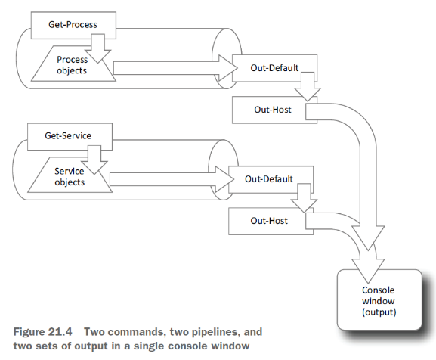
Scripting (cont.)
Notes:
Get-Process
Get-Service

Slide 64
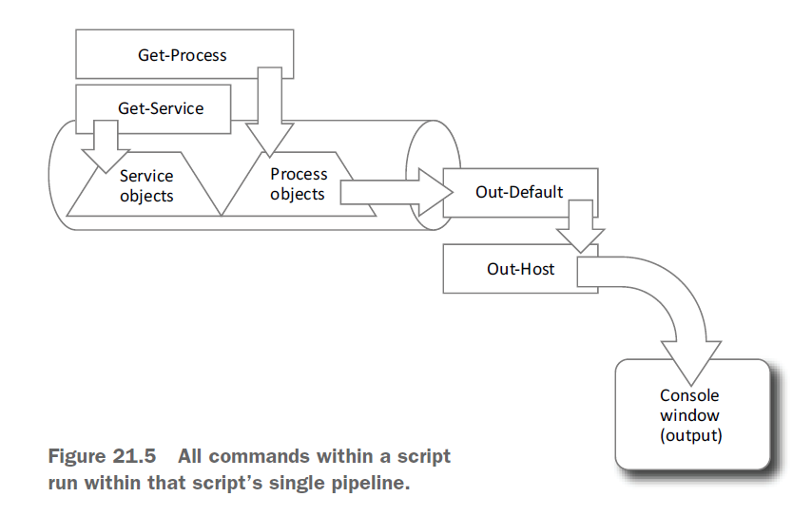
Scripting (cont.)
Notes:
Ise “C:\Users\honey\Google Drive\Presentations\PowerShell\PowerShell Crash Course\Scripting-Demo.ps1”
Ise “C:\Users\honey\Google Drive\Presentations\PowerShell\PowerShell Crash Course\Scope.ps1”

Slide 65
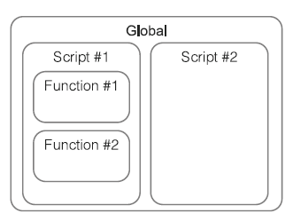
Variable Scope
Notes:
Ise “C:\Users\honey\Google Drive\Presentations\PowerShell\PowerShell Crash Course\Scope.ps1”
function x {$x + (.\scope.ps1)}

Slide 66
Parameters
Turn variables into parameters
[CmdletBinding()]
[Parameter(Mandatory=$True,HelpMessage="Enter a computer name to query")
[Mandatory], [String], [Int], [alias(‘hostname’)]
[ValidateSet(2,3)]
help about_functions_advanced_parameters
Notes:
Ise “C:\Users\honey\Google Drive\Presentations\PowerShell\PowerShell Crash Course\Get-DiskInventory.ps1”
Code “C:\Scripts\Publish\PowerShell\Files\Backup-Files.ps1”

Slide 67
random tips, tricks, and techniques
Regular expressions to parse text files
Operators: -as, -is, -replace, -join, -split, -in, -contains
String Manipulation
Date manipulation
Notes:
Regex
Used with -match and -cmatch (case sensitive)
Get-WinEvent -Path "C:\Users\honey\Documents\PowerShellCTF\Win7-security.evtx" | where { $_.id -eq 4624 } | select -ExpandProperty message | Select-String -Pattern "Logon\D+:\s+3" | measure
Operators: -as, -is, -replace, -join, -split, -in, -contains
as - operator produces a new object in an attempt to convert an existing object into a different type
1000 / 3 -as [int]
Is - It’s designed to return True or False if an object is of a particular type or not
123.45 -is [int]
"SERVER-R2" -is [string]
$True -is [bool]
(Get-Date) -is [datetime]
Replace - operator is designed to locate all occurrences of one string within another and replace those occurrences with a third string (linux sed command)
"192.168.34.12" -replace "34","15"
join and -split operators are designed to convert arrays to delimited lists, and vice versa (linux Cut, and Awk commands)
$array = "one","two","three","four","five"
$array -join "|"
$string = $array -join "|"
split - It takes a delimited string and makes an array from it
$array = (gc computers.tdf) -split "`t"
Contains – operator is used to test whether a given object exists within a collection
$collection = 'abc','def','ghi','jkl'
$collection -contains 'abc'
Like - operator is designed for wildcard string comparisons
'this' -contains '*his*'
String Manipulation
"Hello" | gm
IndexOf() tells you the location of a given character within the string:
"SERVER-R2".IndexOf("-")
ToLower() and ToUpper() convert the case of a string
$computername = "SERVER17"
$computername.tolower()
Trim() removes whitespace from both ends of a string;
$username = " Don "
$username.Trim()
TrimStart() and TrimEnd() remove whitespace from the beginning or end of a string, respectively
Date manipulation
get-date | gm
$90daysago = $today.adddays(-90)

Slide 68
Never the end
Custom formatting views
Custom type extensions
Script and manifest modules
Using databases
Workflows
Pipeline troubleshooting
Complex object hierarchies
Globalization and localization
Proxy functions
Constrained remoting and delegated administration
Using .NET
Splatting
PowerShell’s simplified scripting language
iScope
Functions, and the ability to build multiple tools into a single script file
Error handling
Writing help
Debugging

Slide 70
References
https://docs.microsoft.com/en-us/powershell/scripting/learn/windows-powershell-glossary?view=powershell-5.1
https://docs.microsoft.com/en-us/dotnet/framework/additional-apis/index
https://docs.microsoft.com/en-us/powershell/scripting/samples/creating-a-custom-input-box?view=powershell-5.1

Slide 71
References (cont.)
https://docs.microsoft.com/en-us/powershell/module/microsoft.powershell.core/about/about_commonparameters?view=powershell-6
https://devblogs.microsoft.com/scripting/using-scheduled-tasks-and-scheduled-jobs-in-powershell/
https://docs.microsoft.com/en-us/powershell/module/microsoft.powershell.core/about/about_language_modes?view=powershell-5.1

Slide 72
Powershell v5 Security References
https://blogs.msdn.microsoft.com/daviddasneves/2017/05/25/powershell-security-at-enterprise-customers/
https://www.blackhillsinfosec.com/powershell-logging-blue-team/
https://www.stigviewer.com/stig/windows_10/2017-02-21/finding/V-68819
https://www.stigviewer.com/stig/windows_server_20122012_r2_member_server/2018-10-30/finding/V-80475

Slide 73
Questions
Upcoming Talks/Training
Crash Course in PowerShell (Dec 14)
ISSA & BSidesCharm (Potentially)
SEC505 Windows Security and PowerShell Automation (Feb 06)
SANS
PowerShell Pipeline Deep Dive (April)
BSidesCharm (Potentially)
LinkedIn
in/james-Honeycutt
Twitter
@P0w3rChi3f
Website
JamesHoneycutt.net

